Slide 1
Rescuing the Jews – Denmark’s glorious moment during World War Two?
Tallinn 16.th of November 2017
Peder Jacob Ellehave Kragh – Baltic Initiative and Network

Slide 2
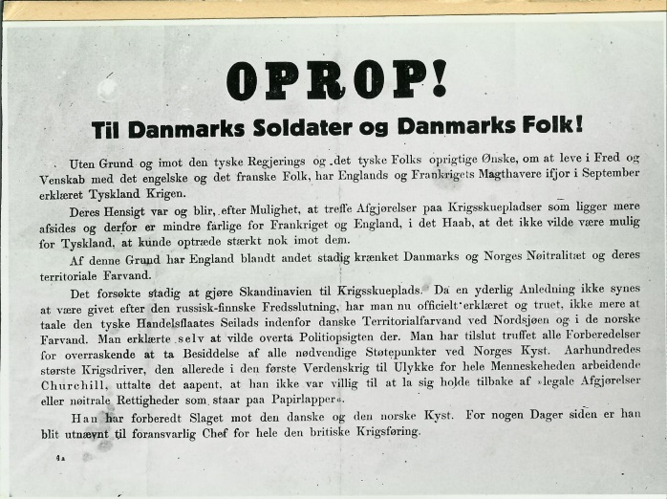
Denmark and World War Two
Occupied 9.th April 1940 (as part of the attack on Norway)
Everyday life continued– German “protection force”
Military still existed with restrictions
Police operated normally (unless it concerned the German “protection force”)
Political life – a unity Government was formed
Free election in 1943!
29.th of August 1943 – government resigned, military disarmed
October 1943 – capture of the Jews
19. of September 1944 – police force dissolved
4.th / 5.th May 1945 Liberation
The resistance movement – at first small and insignificant, later more manpower in 1941 (attack on USSR), 1943 and 1944.

Slide 3
Monopoly (Matador) – Danish popular history writing
Television drama produced 1978-1981 (24 episodes)
Setting: Korsbaek (fictional provincial town) 1929-1947
As accurate as possible – items, dressing, political topics and so on
This episode: 1943

Slide 4
Problems with this scene in Monopoly
Denmark do not have many heroic stories from World War Two – rescuing the Jews is one of the few
Tells the stereotypic story about the rescuing of the Jews
The drama focuses mainly on strong women - the wife of the bank director was for example until this scene a weak woman!
The resistance movement in the movie all more or less belong to a pacifistic intellectual center party in Danish politics – this was certainly not the case in the real world (i.e. usually the resistance fighters came from a background as communist’s, conservative’s, social democrat's and to some extent farmers (liberals))
The scene tells (as most movies and dramas) just as much about it’s present time - 1980

Slide 5
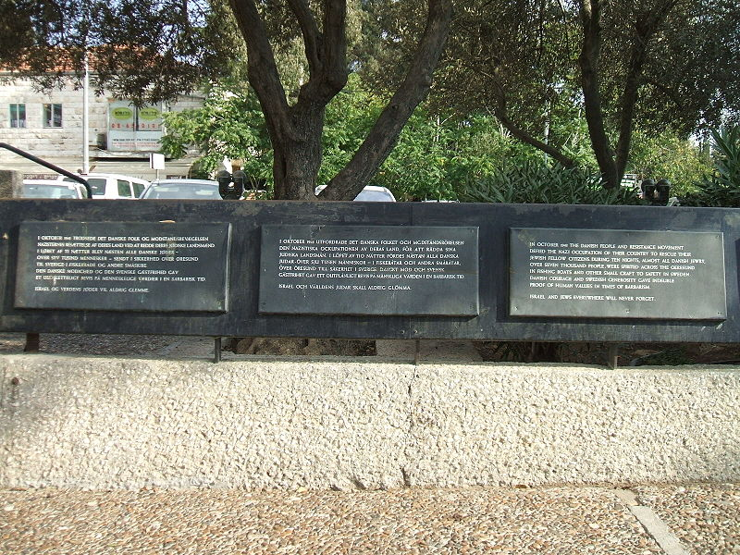
Jewish escape to Sweden – October 1943
App. 7.000 Jews in Denmark (most lived in Copenhagen)
Integrated into the Danish society
Left alone 1940-1943
273 Jews were arrested (120 at the same time at the roof of Gilleleje Church)
The rest escaped to Sweden
The arrested Jews were send to KZ-Theresienstadt
The memorial plate in Jerusalem for the Danish saving of Jews

Slide 6
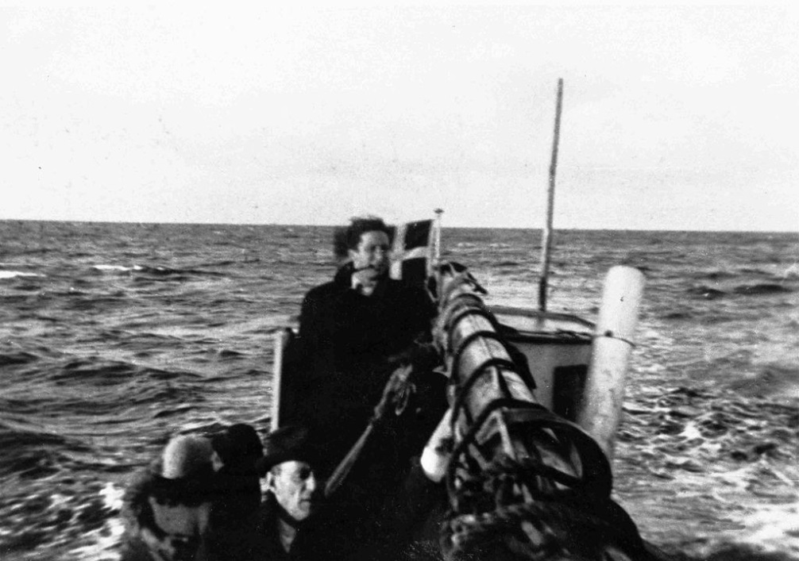
Jewish escape to Sweden – October 1943 – Why was it a success?
Early information about the nazi action from Georg Ferdinand Duckwitz to Danish politicians
Most Danes either helped the Jews or did nothing to help the Nazis
The German navy did not patrol Oeresund Strait to Sweden in the beginning of October – very little help to Gestapo
Sweden cooperated
The Danish sailors demanded money for the passage
The Danish policy of cooperating with the German occupation force?
Boat from Denmark to Sweden with Jewish refugees

Slide 7
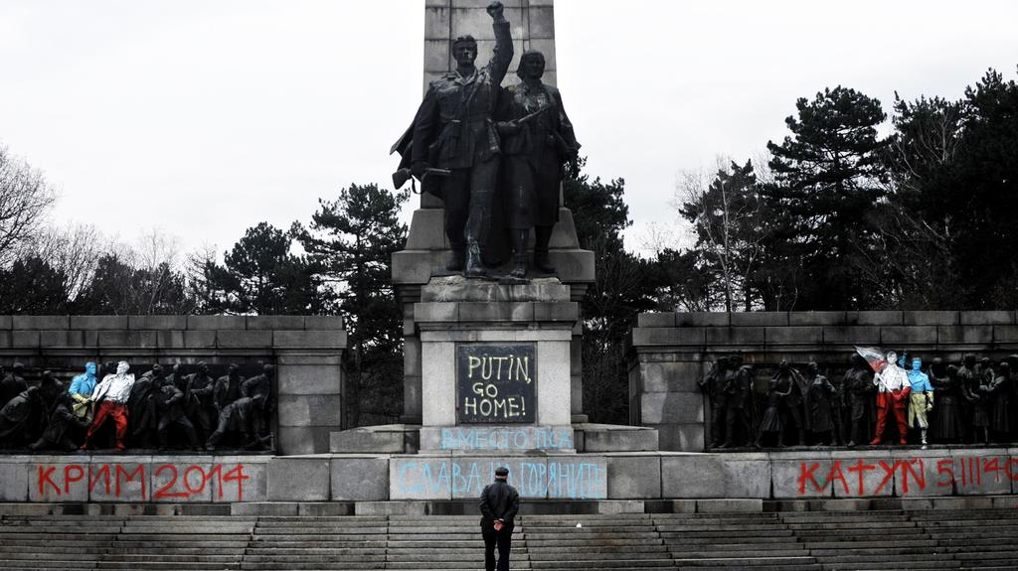
Bulgaria – another example of rescuing of the Jews
Bulgaria was allied until 1944 with Germany
App. 50.000 Jews lived in Bulgaria
1943 - After demonstrations and political pressure (from among others leading politicians and the Bulgarian orthodox patriarch) the Jews were not handed over to Nazi Germany
Jews in Bulgarian occupied territories in Macedonia and Greece were handed over
New controversy between Russia and Bulgaria about who saved the Bulgarian Jews (31.st of October and 2.nd of November 2017)
After the war most Jews left Bulgaria for Israel
Pictures of the Red Army monument in Sofia after the last graffitti 31.st of October 2017

Slide 8
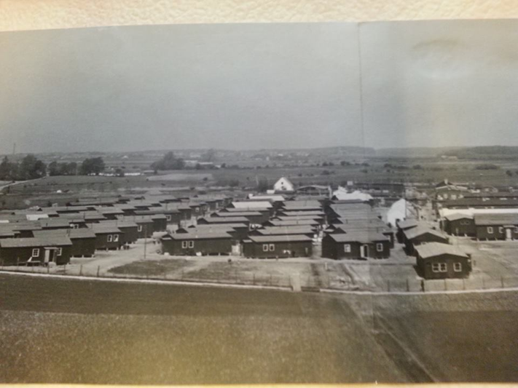
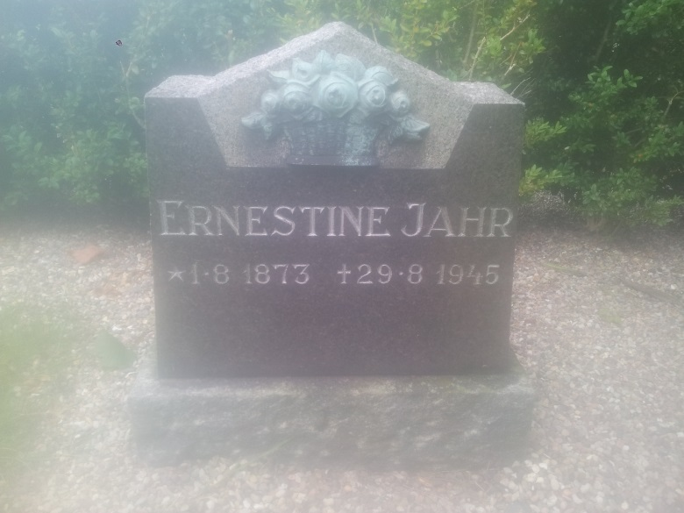
German refugees in Denmark 1945-1947(1949)
Arrived in 1945 – app. 230.000
Transferred to different camps
Mainly women, children and elderly
App. 17.000 died in Denmark
Negative attitude from the Danish authorities and many Danes towards the refugees
Above: Refugee camp Hasseloe (at Falster). Existed 1945-1947
Left: Tombstone over one of the refugees, that died at Hasseloe

Slide 9
Conclusion
The image of Denmark during World War Two is often shaped by popular stories
Popular belief that Danes are peaceful and help people in need
Unlike the belief – it was only a few that took part in rescuing people and the resistance movement
Modern Danish historians have began to look into this “fairy” tale picture

